Slide 1
Navigating the Future of Online Shopping
Target Dataset Analysis using SQL & Python
Presented by: Lopita Mishra

Slide 2
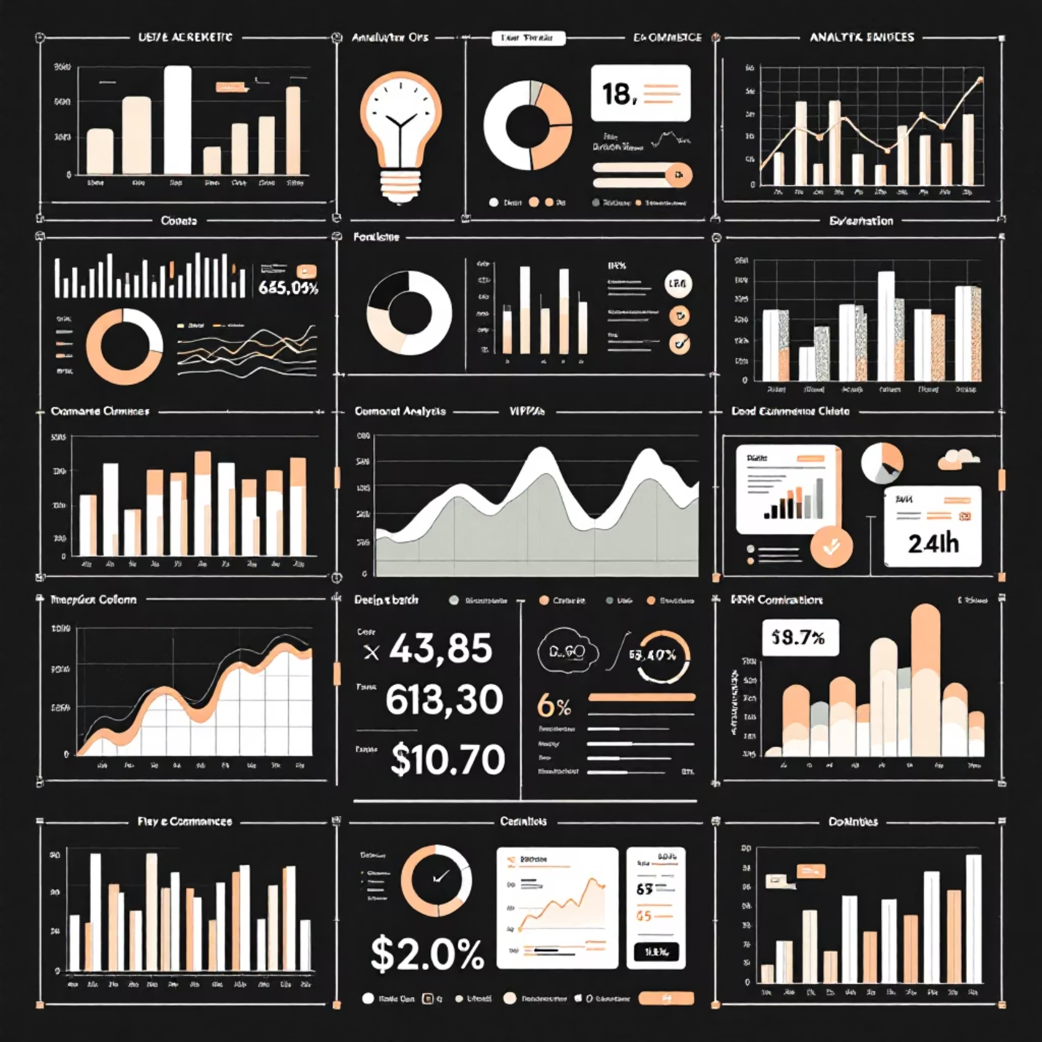
Objective
Our analysis aims to unlock valuable insights from comprehensive ecommerce datasets, examining customer behaviour, order patterns, and product performance.
Extract actionable insights from customer, order, product, and seller datasets
Analyse sales trends, order patterns, and customer behaviour dynamics
Visualise key metrics to support data-driven decision-making and strategic planning

Slide 3
Data Overview
Our comprehensive analysis draws from seven interconnected datasets, providing a 360-degree view of the ecommerce ecosystem.
Dataset
Records
Key Columns
Customers
99,441
customer_id, city, state
Orders
99,441
order_id, customer_id, timestamps
Order Items
112,650
order_id, product_id, seller_id, price
Payments
103,886
order_id, payment_type, installments, value
Sellers
3,095
seller_id, city, state
Products
32,951
product_id, category, price
Geolocation
1,000,163
zip_code, lat, lng, city, state

Slide 4
Basic Insights
Customer Distribution
2017 Order Volume
A robust 615,580 orders were processed in 2017, demonstrating strong platform engagement and sustained customer activity throughout the year.
Analysis reveals customers spread across numerous unique cities throughout India, indicating widespread market penetration and diverse geographical reach.
Payment Flexibility
Significant portion of customers opted for installment-based payments, reflecting the importance of flexible payment options in driving conversions.

Slide 5
Category Performance Analysis
Our analysis of sales distribution across product categories reveals distinct patterns in customer preferences and revenue generation. Understanding these trends enables strategic inventory management and targeted marketing initiatives.
Key findings:
Top-performing categories drive majority of revenue
Customer preferences vary significantly by state
Seasonal trends influence category performance
Horizontal bar charts visualising total sales per category and customer distribution per state provide actionable insights for business strategy.

Slide 6
2018 Monthly Trends & Customer Behaviour
01
Monthly Order Patterns
Order volume fluctuations throughout 2018 reveal seasonal trends and peak shopping periods, essential for inventory planning and resource allocation.
02
City-Level Analysis
Top 20 cities by average products per order showcase metropolitan areas driving higher basket values and premium purchasing behaviour.
03
Revenue Distribution
Percentage revenue contribution by product category highlights strategic focus areas for marketing investment and supplier partnerships.
04
Price Sensitivity
Scatter plot analysis of price versus purchase frequency reveals optimal pricing strategies and customer value perception patterns.

Slide 7
Advanced Analytics Deep Dive
Sophisticated analytical techniques reveal patterns beyond surface-level metrics, providing strategic foresight for business growth.
1
2
Customer Value Trajectory
Year-over-Year Growth
Moving average analysis of order values across sample customers demonstrates purchasing evolution over time, identifying high-value customer segments and growth opportunities.
Sales growth comparison reveals acceleration trends, highlighting successful strategies and areas requiring adjustment for sustained expansion.
3
Retention Metrics
Six-month customer retention analysis provides critical insights into loyalty programmes effectiveness and customer satisfaction levels.

Slide 8



Tools & Methodology
SQL/MySQL
Python Analytics
Google Colab
Robust data extraction, complex aggregations, and sophisticated calculations form the foundation of our analysis pipeline.
Leveraging Pandas, Seaborn, and Matplotlib for advanced statistical analysis and compelling data visualisation.
Interactive notebooks enable collaborative analysis, reproducible research, and seamless sharing of insights across teams.
Conclusion: This comprehensive analysis identifies high-revenue categories, quantifies customer retention, ranks seller performance, and uncovers city-level patterns—empowering targeted marketing strategies and data-driven inventory planning for sustainable growth.

Slide 9
ThANK YOU

